Slide 1

Module 1
Regression Basics
Notes:
Guidelines
Use section headers to chunk content in your presentation.
Use the same style of section header throughout your presentation.
Keep your title to no more than 2 lines.

Slide 2
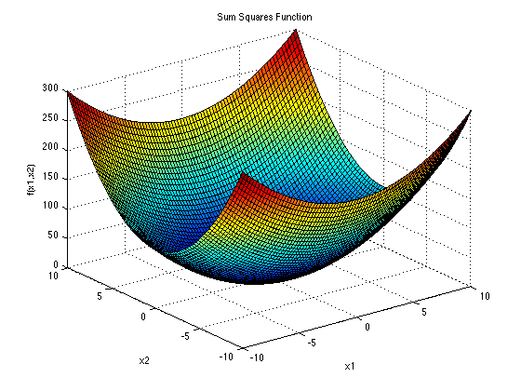
The Least-Squares Method
Notes:
Guidelines
Use a title slide at the beginning of your presentation. There are 9 variations of title slides to choose from.
If you will have a series of slideshows, we recommend using the same style of title slide for each presentation.
Keep your title to no more than 2 lines.
Do not change the font style or font size of the title or subtitle.

Slide 3
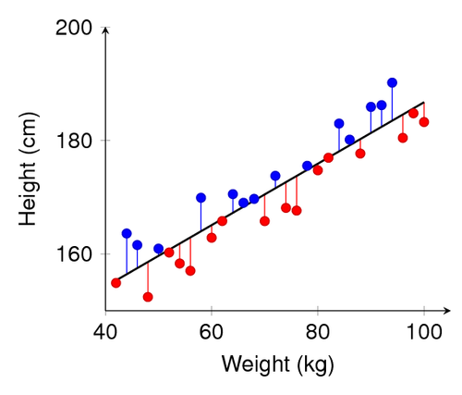



Sum of Squares Error
The distance from each actual value to the regression line is called the residual: $e_{i}=y_{i}−{\hat{y}}_{i}$
$∑e_{i}$= 0
$$SSE= ∑e_{i}$$

Slide 4
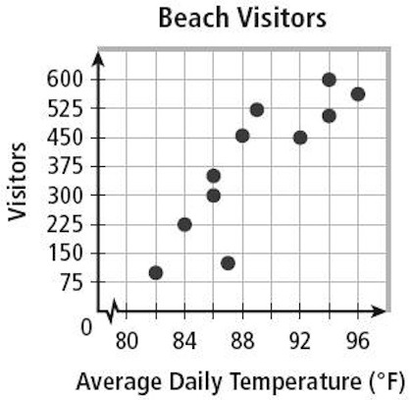


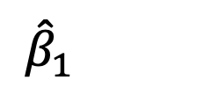
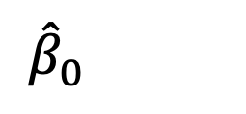
Sum of Squares Error
The sum of squared errors is an important metric in regression
SSE will depend on the choices of ${\hat{β}}_{0}$ and ${\hat{β}}_{1}$
$$SSE$$
${\hat{β}}_{0}$
${\hat{β}}_{1}$

Slide 5
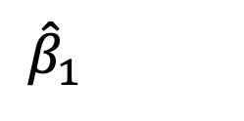
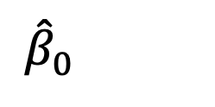
Sum of Squares Error
The sum of squared errors is an important metric in regression
SSE will depend on the choices of ${\hat{β}}_{0}$ and ${\hat{β}}_{1}$
$$SSE$$
${\hat{β}}_{0}$
${\hat{β}}_{1}$

Slide 6

The Least-Squares Method
Involves choosing ${\hat{β}}_{0}$ and ${\hat{β}}_{1}$such that SSE is a minimum
$$SSE$$
${\hat{β}}_{0}$
${\hat{β}}_{1}$

Slide 7

How Are ${\hat{β}}_{0}$ and ${\hat{β}}_{1}$ calculated?
We can use math to derive the minimum of SSE
$$SSE$$
${\hat{β}}_{0}$
${\hat{β}}_{1}$

Slide 8
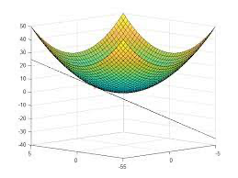
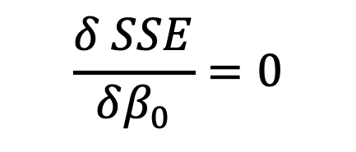
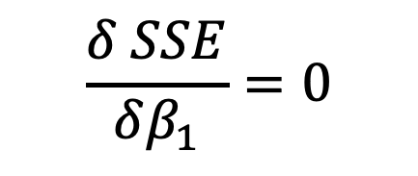
How Are ${\hat{β}}_{0}$ and ${\hat{β}}_{1}$ calculated?
We can use math to derive the minimum of SSE
$$\frac{δ SSE}{δβ_{1}}=0$$
$$\frac{δ SSE}{δβ_{0}}=0$$

Slide 9
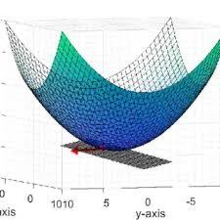

How Are ${\hat{β}}_{0}$ and ${\hat{β}}_{1}$ calculated?
We can use math to derive the minimum of SSE
$$\frac{δ SSE}{δβ_{1}}=0$$
$$\frac{δ SSE}{δβ_{0}}=0$$

Slide 10

How Are ${\hat{β}}_{0}$ and ${\hat{β}}_{1}$ calculated?
We can use math to derive the minimum of SSE
$$\frac{δ SSE}{δβ_{0}}=0$$
$$\frac{δ ∑{\left(y_{i}−β_{o}−β_{1}x\right)}^{2}}{δβ_{0}}=0$$
$$\frac{δ {\left(∑y_{i}−{nβ}_{o}−β_{1}∑x\right)}^{2}}{δβ_{0}}=0$$
$$2n(∑y_{i}−{nβ}_{o}−β_{1}∑x)=0$$
$${\hat{β}}_{0}=\overline{y}−{\hat{β}}_{1}\overline{x}$$
$$SSE$$
${\hat{β}}_{0}$
${\hat{β}}_{1}$

Slide 11

How Are ${\hat{β}}_{0}$ and ${\hat{β}}_{1}$ calculated?
We can use math to derive the minimum of SSE
$$\frac{δ SSE}{δβ_{1}}=0$$
$${\hat{β}}_{1}=\frac{∑(x − \overline{x})(y−\overline{y})}{∑{\left(x − \overline{x}\right)}^{2}}$$
$$SSE$$
${\hat{β}}_{0}$
${\hat{β}}_{1}$

Slide 12

The Least-Squares Method
Goal: Obtain ${\hat{β}}_{0}$ and ${\hat{β}}_{1}$ such that SSE is a minimum

Slide 13
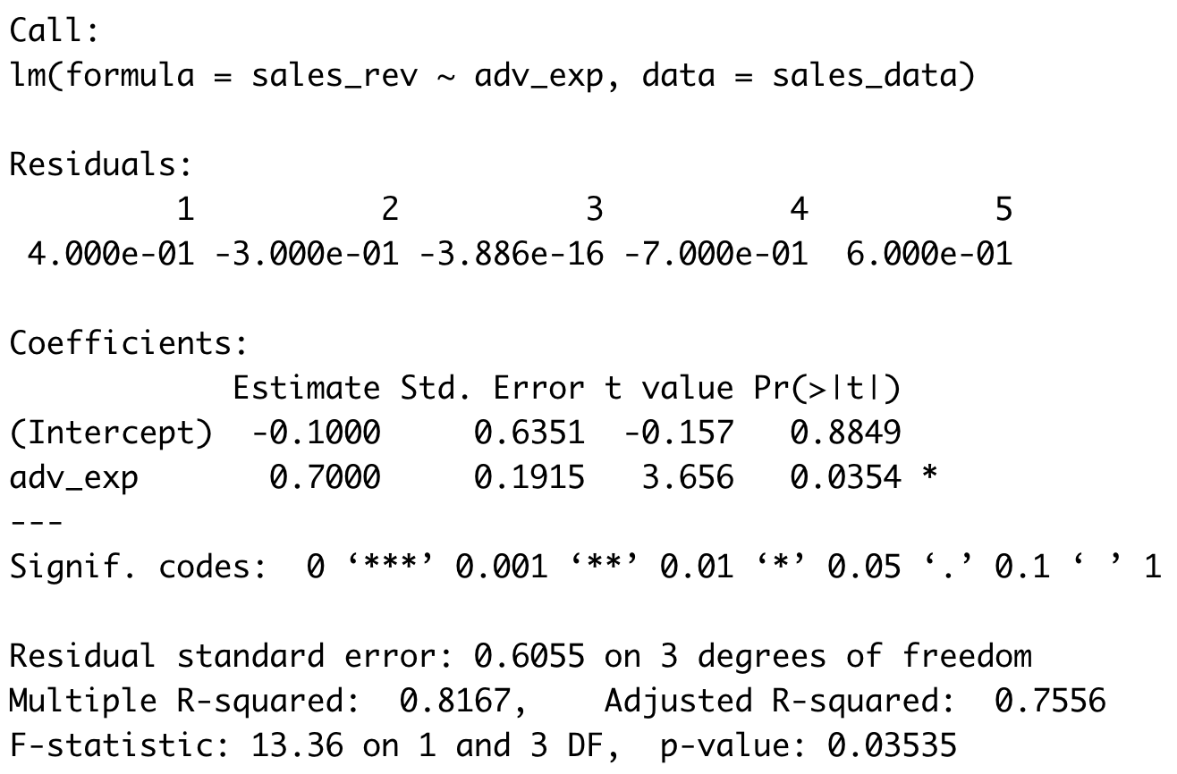



(Least-Squares) Estimates
The summary()function shows the estimates
$${\hat{β}}_{0}$$
$${\hat{β}}_{1}$$

Slide 14

Practice

Slide 15
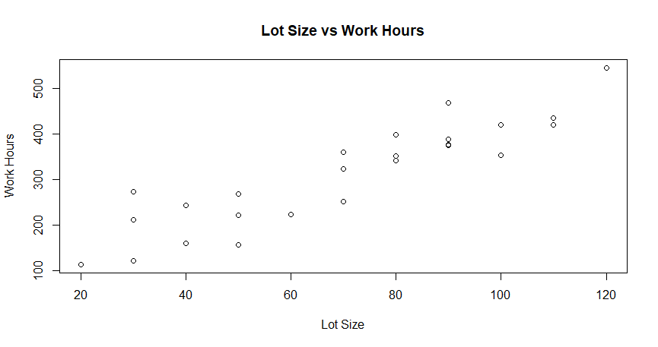
(Least-Squares) Work Hours vs Lot Size
Lot size vs Work Hours

